Slide 1
Car registration by document classification using computer vision
BABEŞ-BOLYAI UNIVERSITY CLUJ- NAPOCA
FACULTY OF MATHEMATICS AND COMPUTER SCIENCE
SPECIALIZATION COMPUTER SCIENCE
Supervisor
Lect. Dr. Petrescu Manuela-Andreea
Author
Pop David Alexandru

Slide 2
Thesis structure
First chapter - Introduction - Identify the problem
Second chapter – Theoretical foundations
Third chapter – Existing methods for document classification
Fourth chapter – Design and implementation of the solution
Fifth chapter – Conclusions & future work

Slide 3
Motivation
Know if your documents are correct in advance.
Avoid third party paid services.
Check the correctness from everywhere, anytime with you phone.

Slide 4
1. First chapter - Introduction
Prepare your documents in advance to register your car.
Main use case: Identify documents from images using OCR (Optical Character Recognition).
Solution provided through a mobile application.

Slide 5
2. Theoretical foundations
How to determine all contours from an image
Compute similarity between two images
How to warp perspective
Enhance methods for images to increase the OCR (Grayscaling, dilate, erode, hide faces using HaarCascade)

Slide 6
3. Existing methods for document classification
Logistic regression – Supervised learning algorithm to indicate the probability of a category
Bidirectional Encoder Representations from Transformers (BERT) – First we train a model on vast amount of text. Next, this pre-trained network is then fine-tuned on taskspecific, labeled data.
Computer vision and pattern matching – Image gets warped and aligned with a template, then text is extracted using an OCR engine and each line has a confidence level assigned by different pattern matching techniques such as regular expressions.

Slide 7
4. Design and implementation
Frontend: Flutter & Dart
Backend: C#(.NET 7, Entity Framework, CQRS & Mediatr) & Python(OpenCV)
Database: PostgreSQL
Unit & integration tests
Continuous Integration: Github Actions
Cloud: Azure
More implementation details during demo

Slide 8
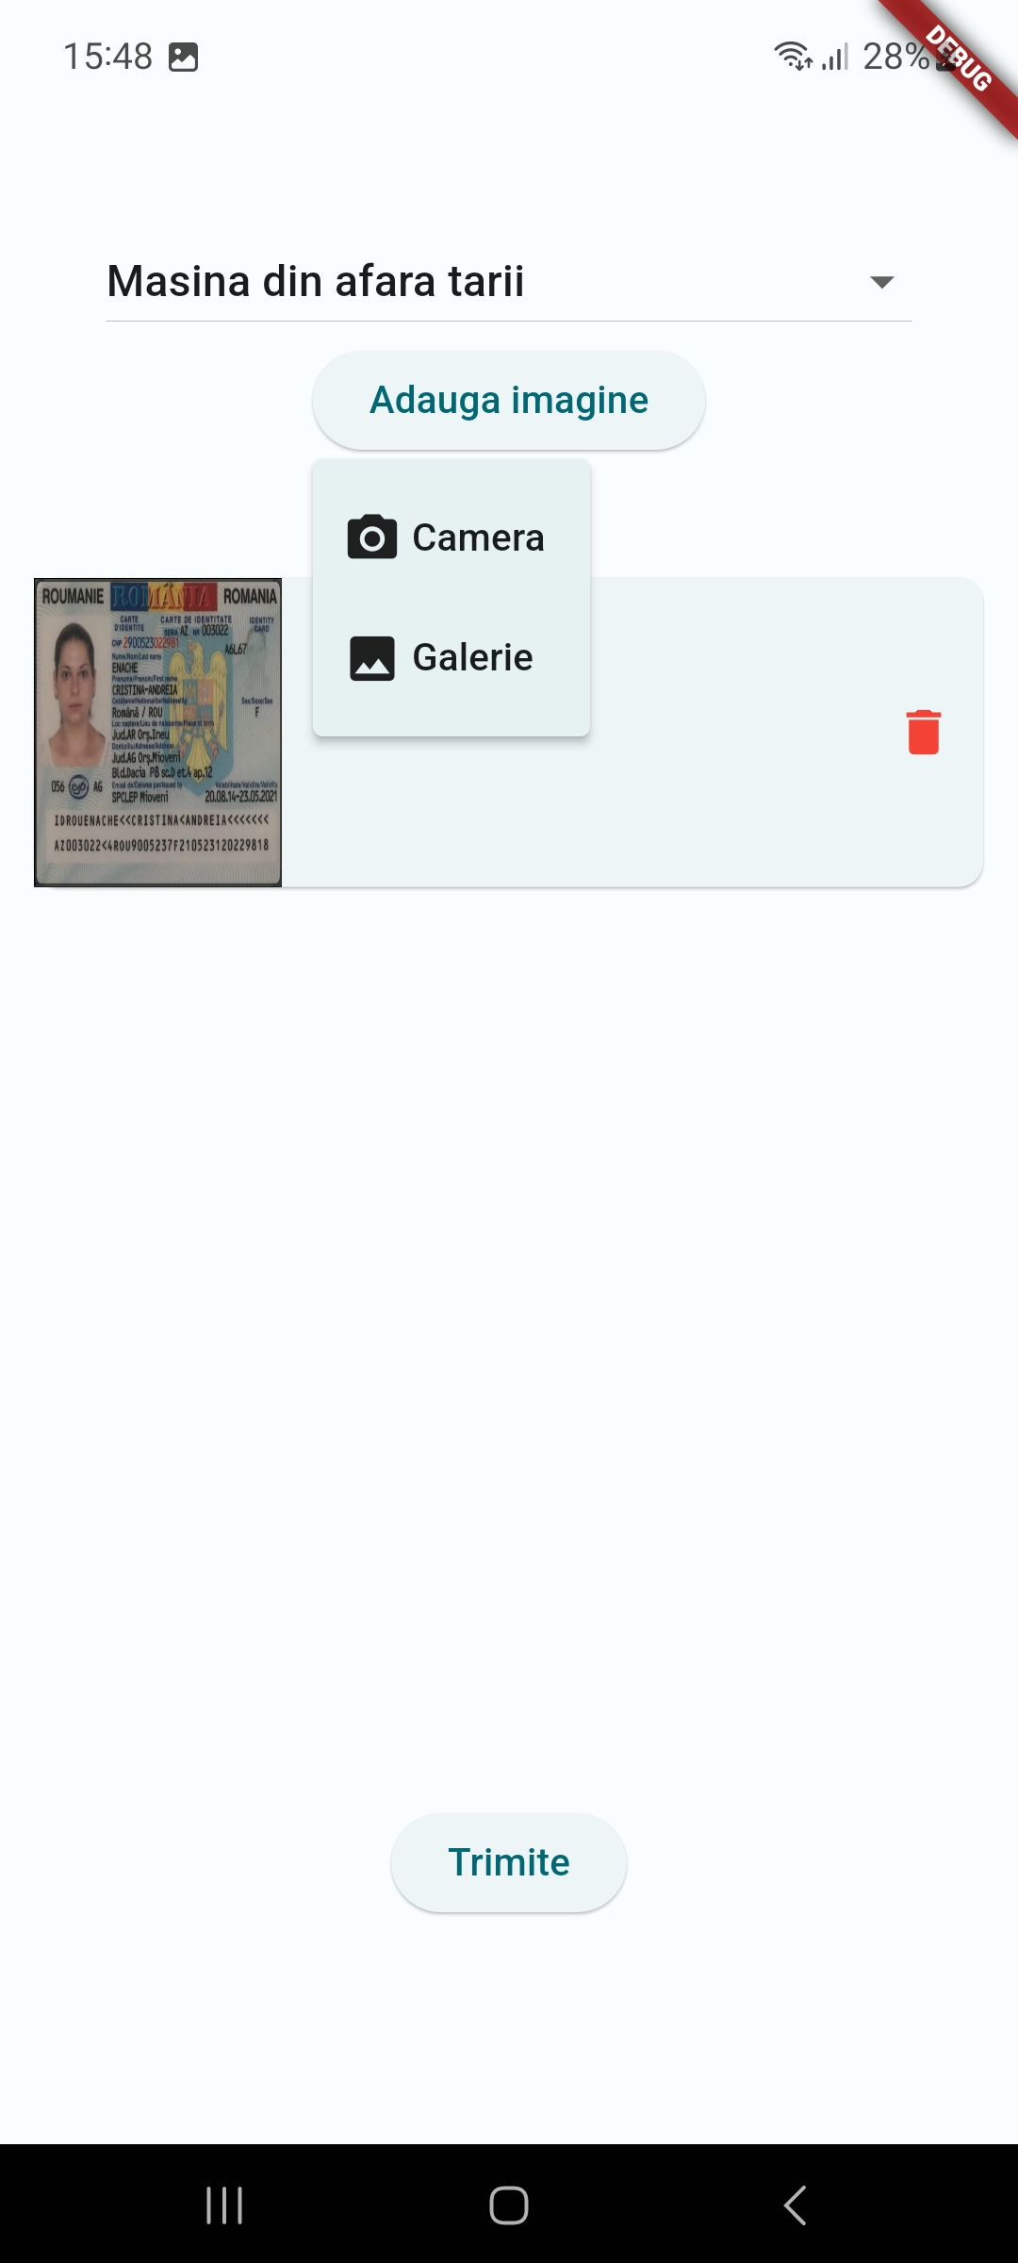
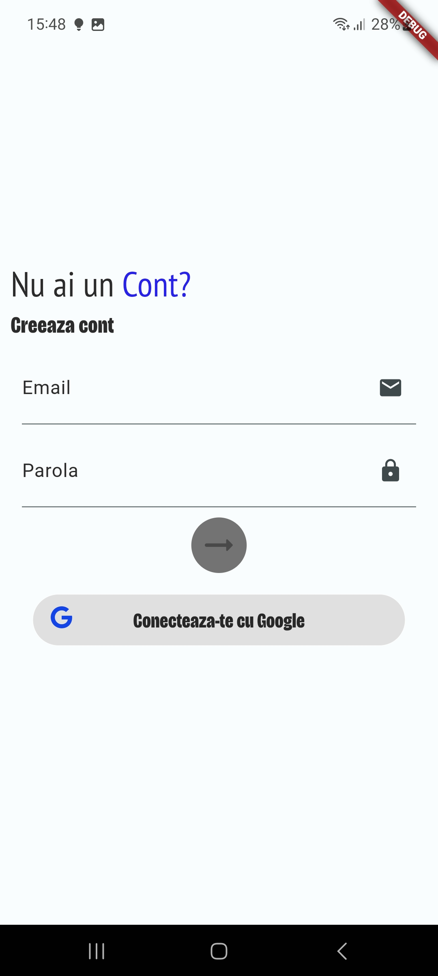
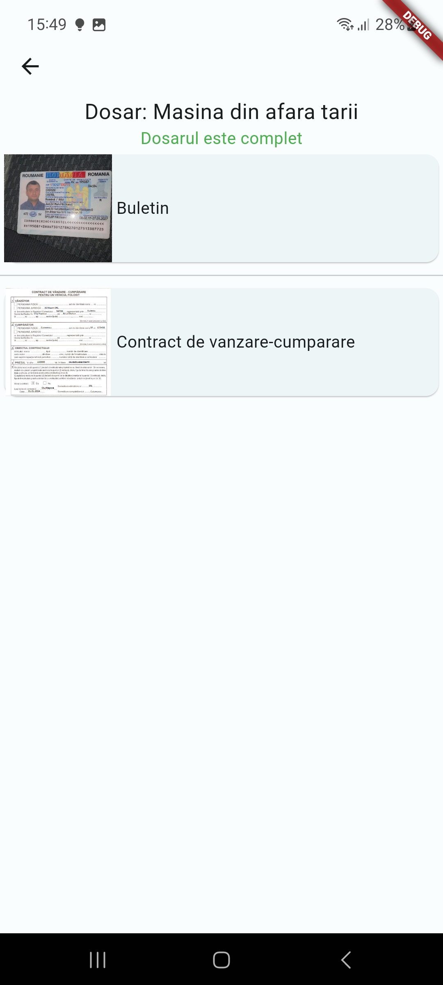
Create new folder screen
Register screen
Completed folder

Slide 9
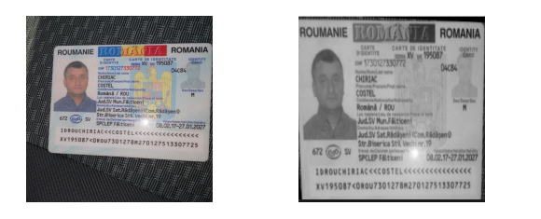
Document classification flow
User uploads an image in the system -> image gets uploaded in the cloud and analyzed -> system shows which steps are completed with the help of Websocket -> folder is completed.

Slide 10
5. Conclusions and future work
System return correct document type for tested images.
Future work should consider decreasing analyzing time, UI & UX improvements and other types of documents.

Slide 11
Demo

